Slide 1

Petabyte Pirates

Slide 2
Team Members
Sean Miller
Farhan Hassan
Dewayne Hafenstein
Teams, GitHub, Google Colab
MS TDSP

Slide 3

Desired Goal(s)
Interests included:
Housing market trends
Predicting failure of Infrastructure
Diagnostics for Healthcare
Diagnostics for Machine Maintenance
And a few more…
Decided on:
Predict the sale price of a house going up for sale

Slide 4
Goals
To be able to predict the sales price of a new listing
To be able to do “what-if” analysis by changing different features.

Slide 5
Selecting the Dataset
We examined the available datasets on
Kaggle
Data.gov
FiveThirtyEight
Zillo
Redfin
Chose
Ames Iowa Housing Sales from Kaggle
https://www.kaggle.com/datasets/shashanknecrothapa/ames-housing-dataset

Slide 6
Dataset Characteristics
Number of Instances: 2,930
Number of Features: 81
Data types include both numerical and categorical values
Record of home sales from January 2006 to July 2010

Slide 7

Discovery
Initial filtering 82 -> 13
Number of desired features (42)
Ratio of missing data by feature
Correlation of features to actual sale price (picked top 13)
Identified engineered features of interest
Correlation of engineered features to actual sale price
Scatter plots of all features having correlation > .50

Slide 8
Features in Final Data Frame
Retained 13 Raw Features
MS SubClass
Overall Quality
Year Built
Year Remod/Add
Basement Finishings
Total Basement Square Feet
First Floor Square Feet
Above Ground Living Area
Number of Full Baths
Garage Year Built
Garage Finishings
Garage Cars
Garage Area
Encoded 6 Features w/ Ordinal Mapping
Exterior Quality
Basement Quality
Heating Quality
Kitchen Quality
Fireplace Quality
Functional
One-Hot Encoded 13 Features
Neighborhood
House Style
Building Type
Sale Condition
Sale Type
Garage Type
Foundation
Exterior Primary Materials
Exterior Secondary Materials
MS Zoning
Lot Shape
Lot Config
Primary Condition
Engineered 10 Features
Quality x Square Feet
Sale Date (Yr Sold + Mo Sold)
House Age
Remodel Age
Age Bucket
Total Square Feet
Total Square Feet w/ Garage
Total Baths
Price per Square Feet
Season Sold

Slide 9
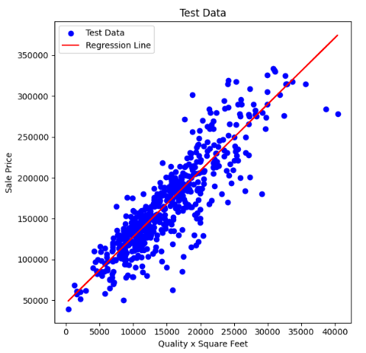
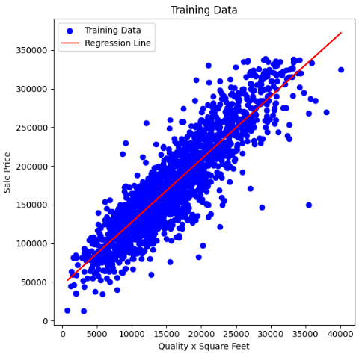
Analysis

Slide 10



Architecture
Front End Web Server
Back End Web Server
Web Application
ML Engine
Port 80/443
Rest API
Ames Iowa Home Sales
Port 10000

Slide 11
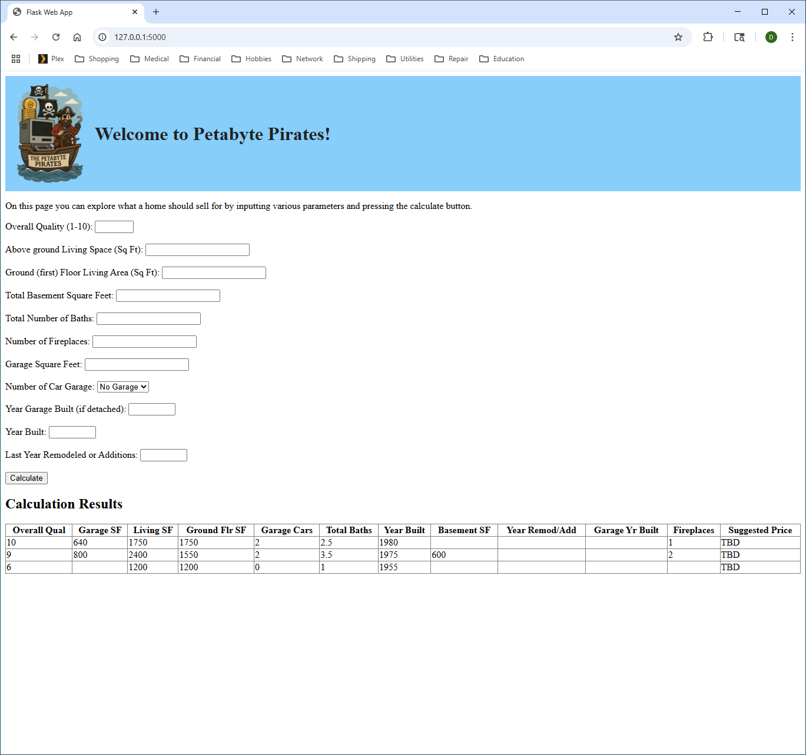
Presentation
Form for user to input parameters to predict price of home. The result of each request is saved as a table below, allowing “what-if” comparisons.
Each result of the input calculation is saved in a table. All columns of the table are sortable. This allows the user to perform what-if comparisons and to compare multiple properties.

